Slide 1




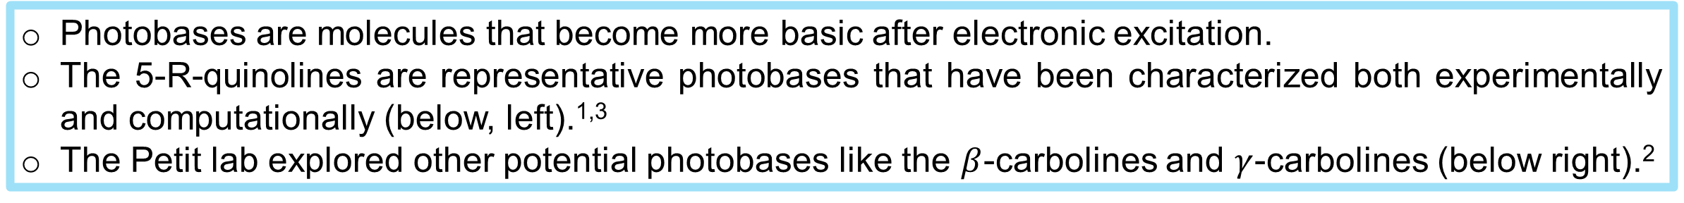
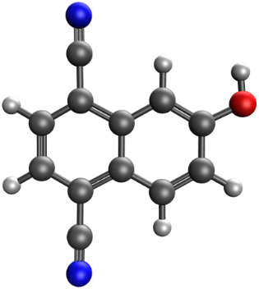
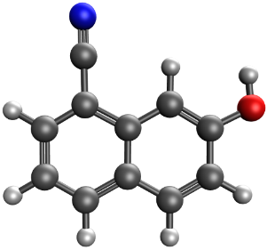
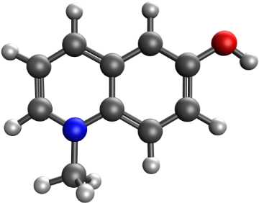
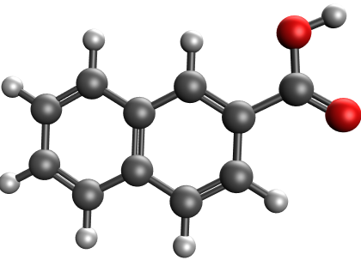
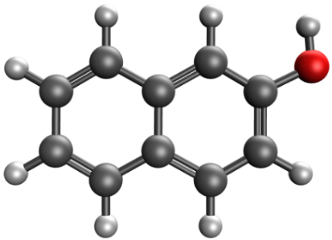
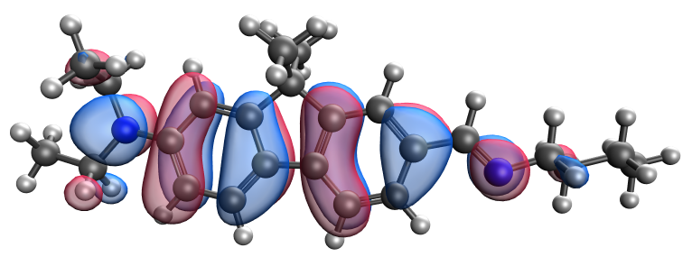
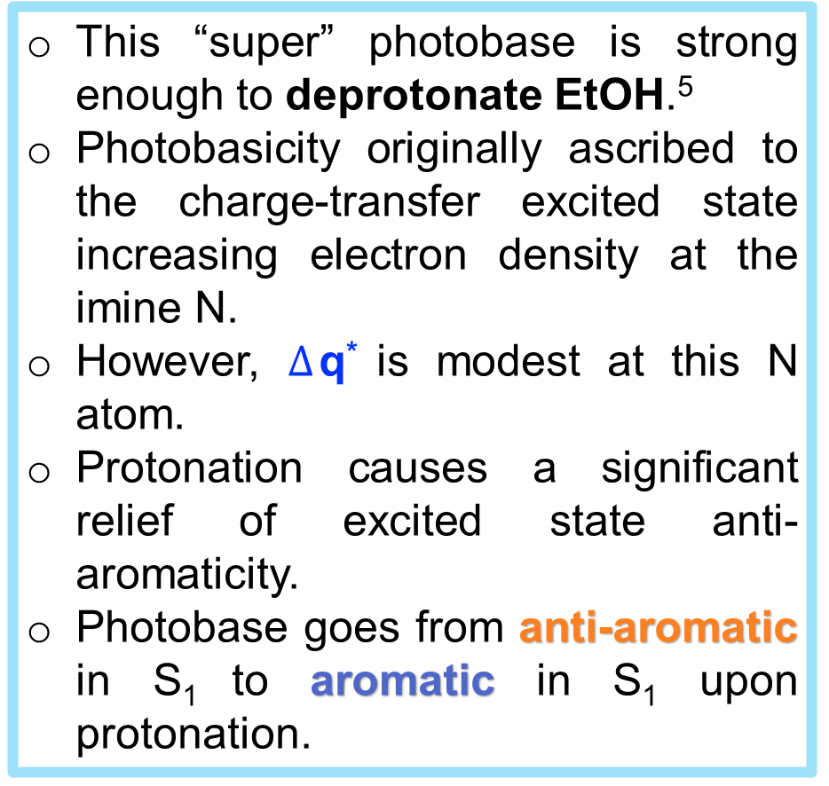
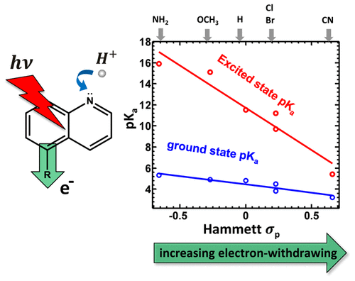
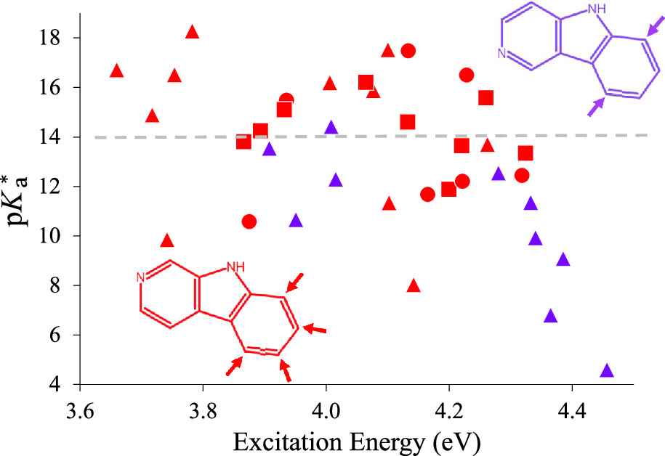
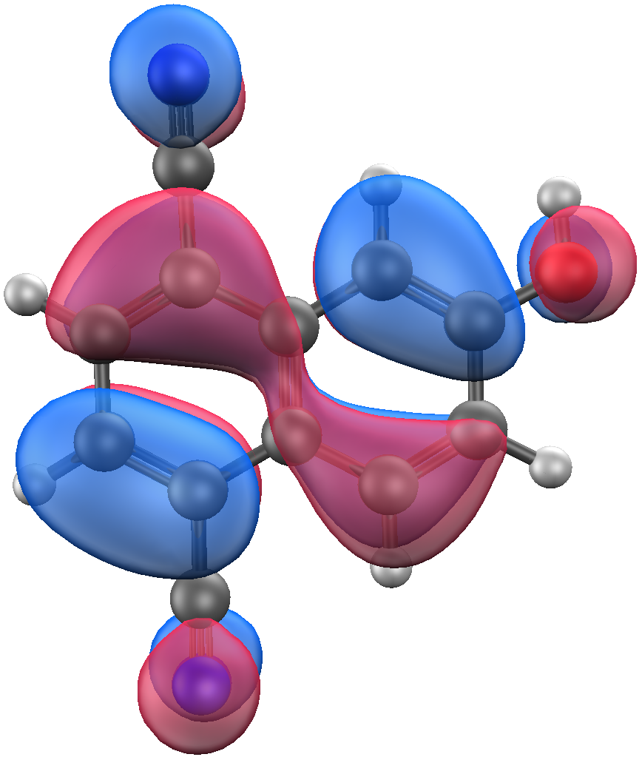
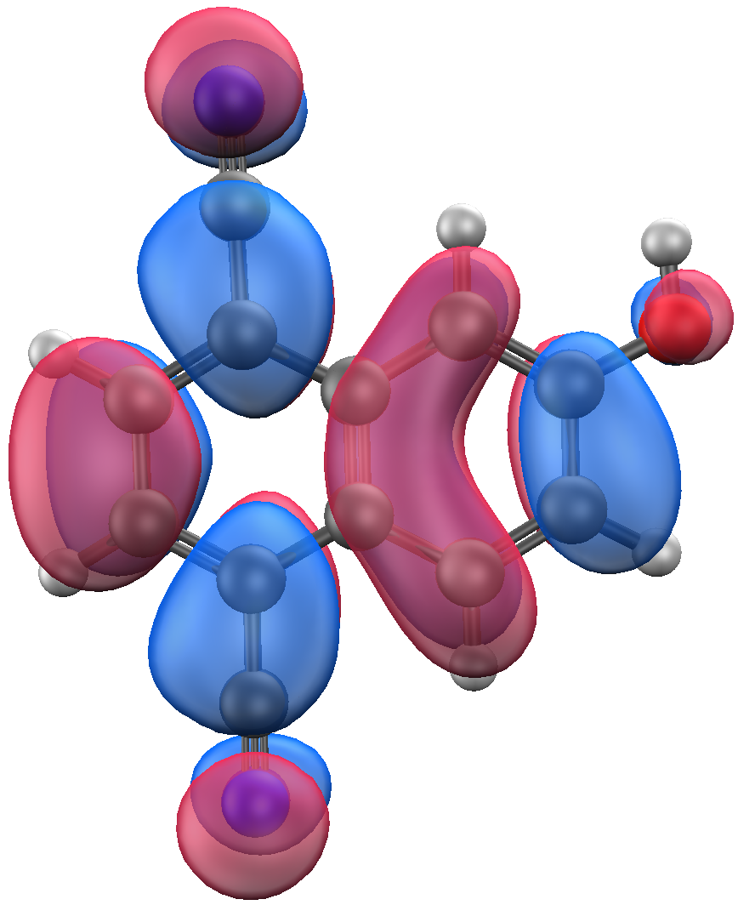

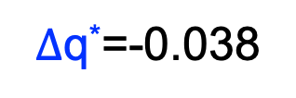
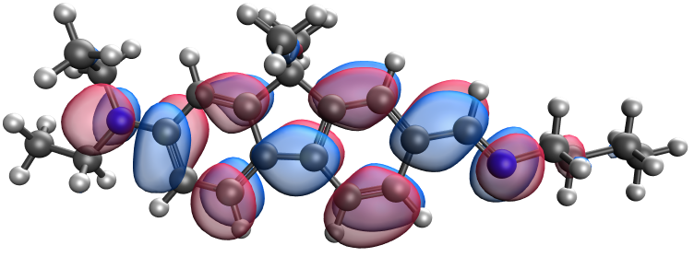
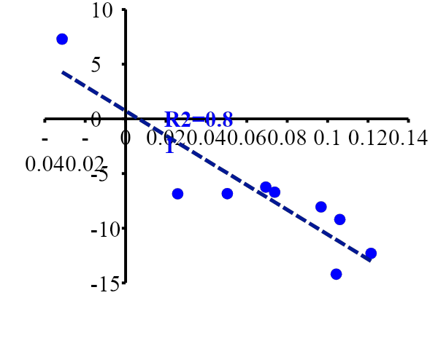
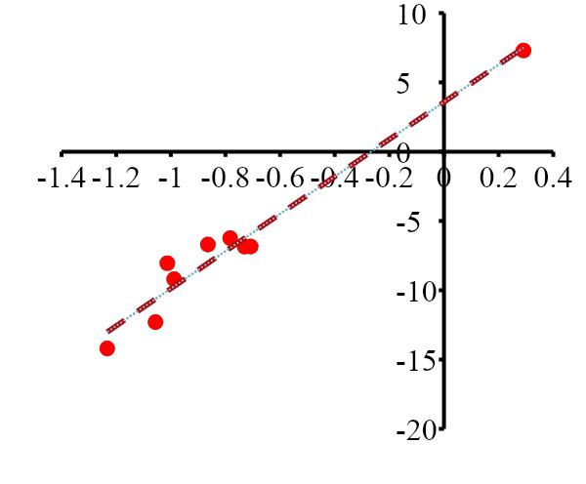
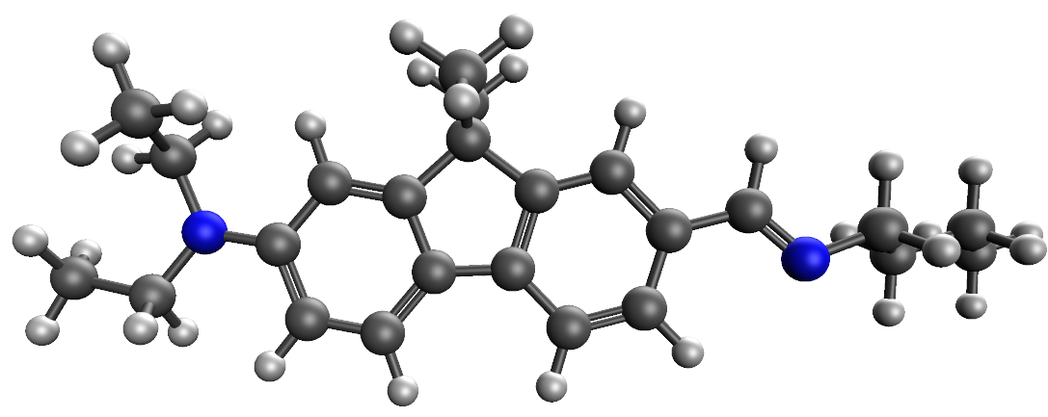


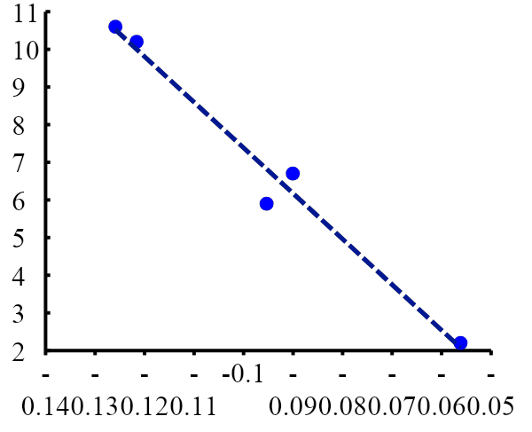
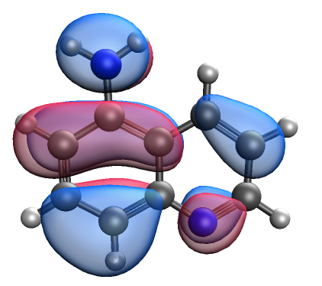

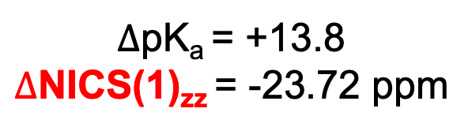


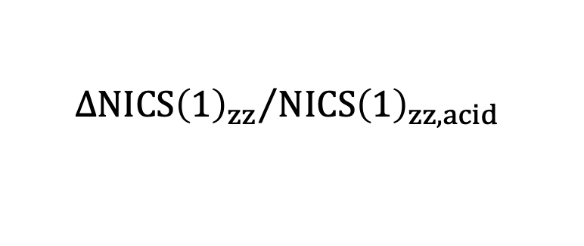
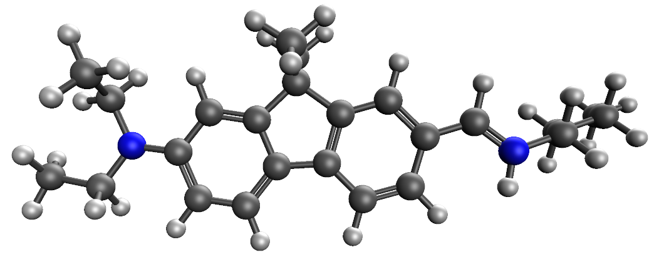

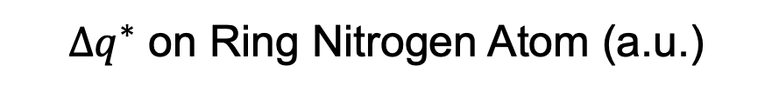
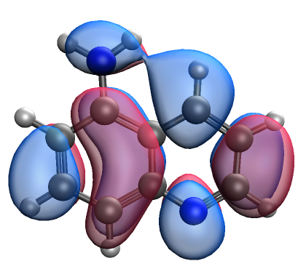
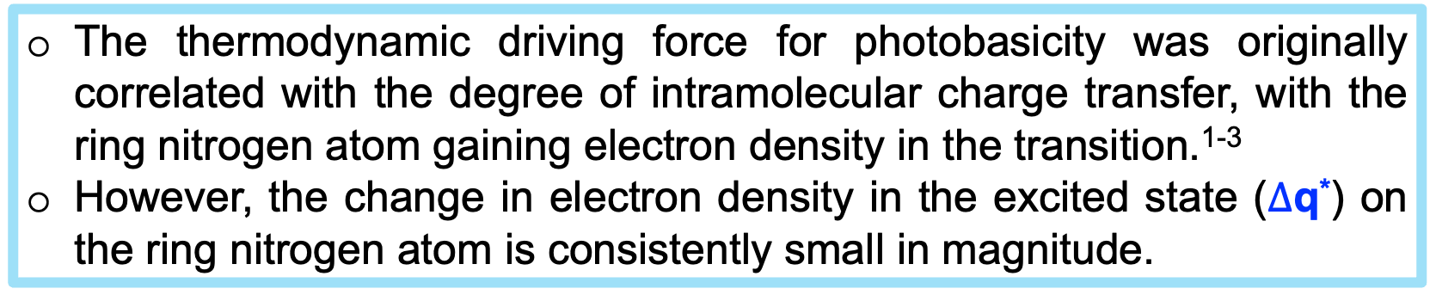
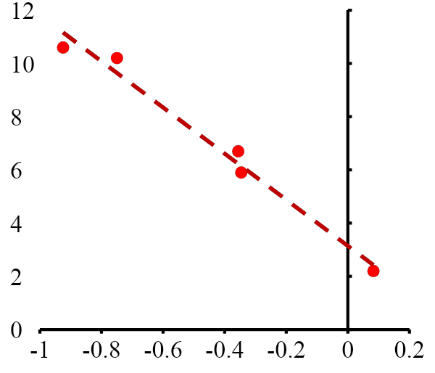


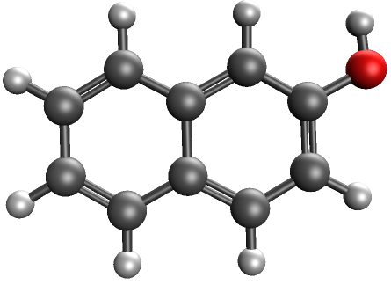
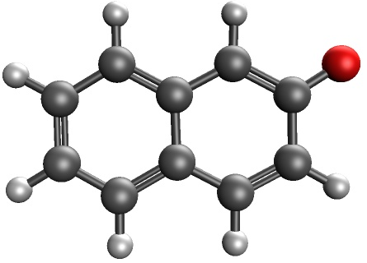





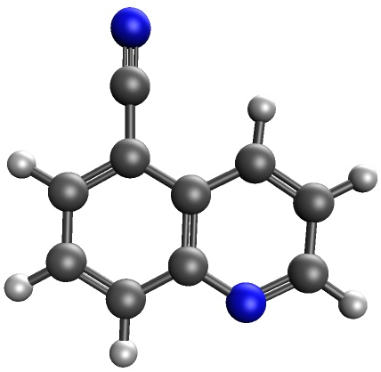
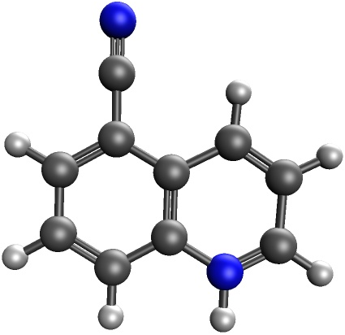
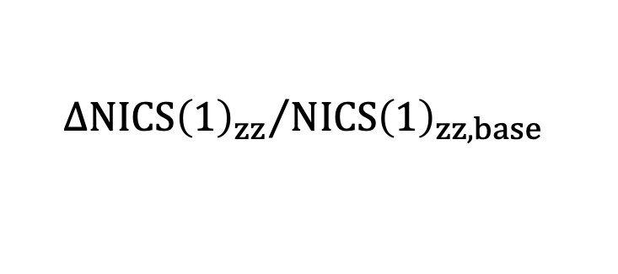

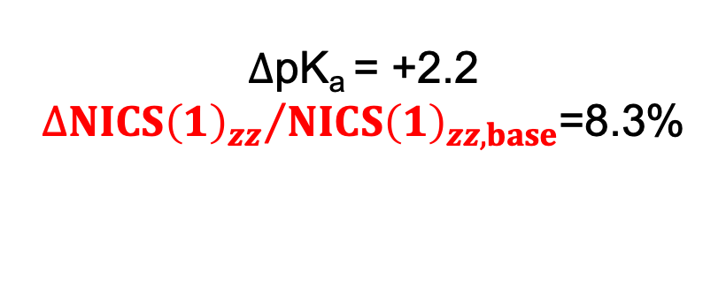
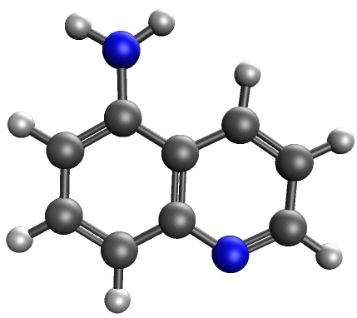
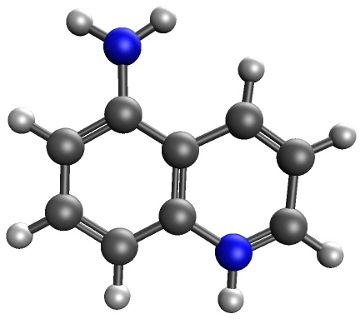
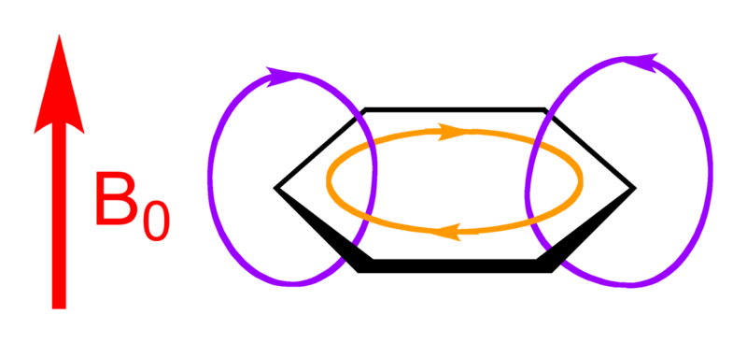

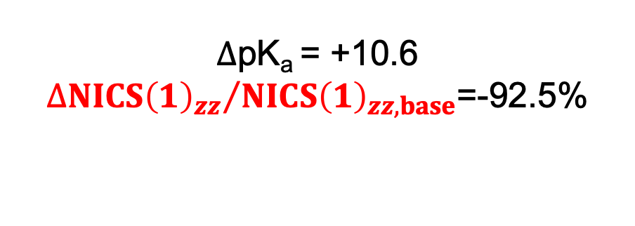
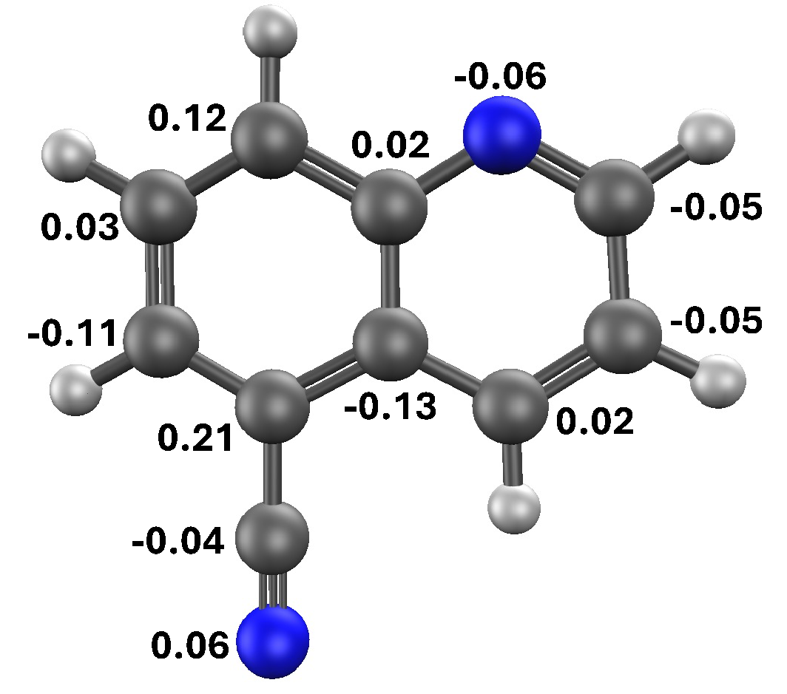
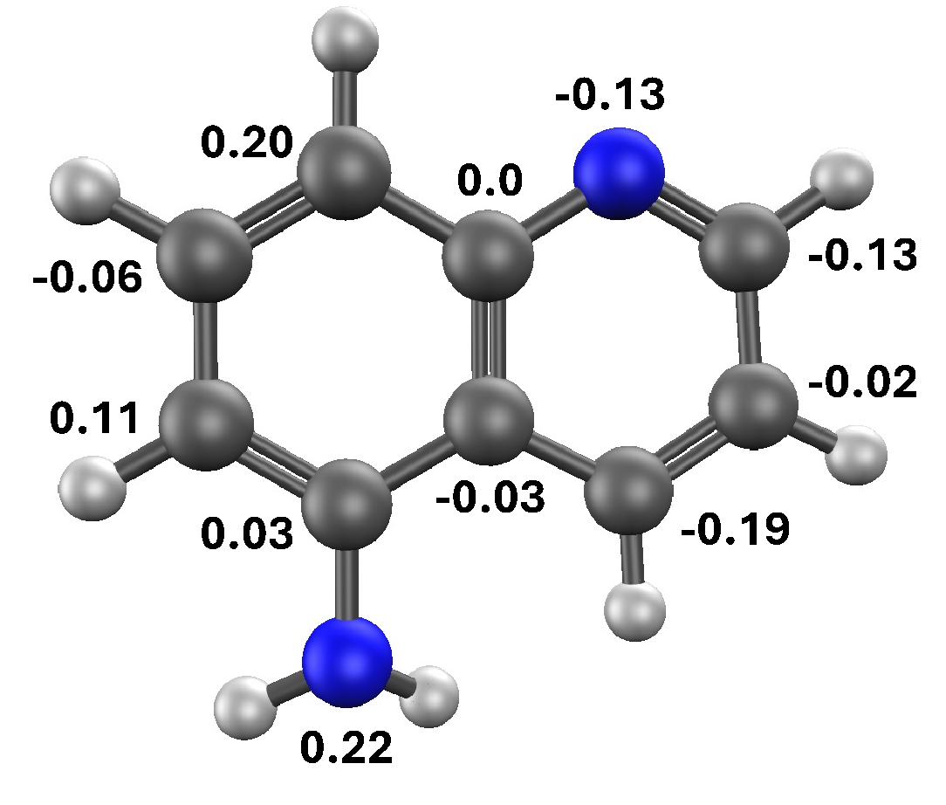
Excited State Anti-Aromaticity Relief as a Quantitative Descriptor of Photoacidity and Photobasicity
Tanner Megna, Saray Angulo, Marco Hernandez, Andrew S. Petit
Department of Chemistry and Biochemistry, California State University – Fullerton, Fullerton, CA 92834-6866, USA
Introduction
Results: Photoacids
Results: A Super-Photobase
R
R = NH₃^{+,} CN, H, Me, OH, OMe
HONTO
The electronic excitation of this strong photoacid shifts electron density away from the OH group, making it more acidic.
HONTO
LUNTO
LUNTO
More Reactive
More Reactive
6.58
13.24
Anti - Aromatic
HONTO
R²=0.97
S₁
More Reactive
The strongest photoacids have a larger decrease in excited state anti-aromaticity and a greater charge-transfer character, with electron density shifting away from the O-H group.
Excited-state anti-aromaticity relief exhibits much stronger correlation with photoacidity strength.
-3.19
-0.72
Aromatic
LUNTO
Results: Photobases
Computational Methods
All 5-R quinolines show a relief in excited state anti-aromaticity after protonation.
Ground state geometry optimizations and frequency calculations performed at the ωB97X-D/def2-SVPD level of theory using Q-Chem software. Excited state geometry optimization and frequency calculation performed at the ωB97X-D/def2-SVPD level of theory using Restricted Open-Shell Kohn-Sham (ROKS) method.
NICS(1)_{zz} were calculated at the state-specific CASSCF/6-31G* level of theory with a GIAO treatment of the magnetic properties using the Dalton software. The active space consisted of all but 2 of the valence π molecular orbitals for the photoacids and all valence π molecular orbitals for the photobases.
Quinoline was excluded from the NICS(1)_{zz} due to difficulties converging the correct state in the state-specific CASSCF calculations.
CHelpG partial charges obtained at the ωB97X-D/def2-QZVPP level of theory.
Light
S₁
Anti-Aromatic
More Reactive
R²=0.98
Aromatic
82.8
75.6
S₁
71.9
99.8
Judy Wu’s group recently explored photoacidity and found a qualitative trend involving excited state anti-aromaticity (left).⁴
The rings are aromatic in the ground state.
The rings became significantly anti-aromatic after the electronic excitation.
They attributed the thermodynamic driving force for excited state proton transfer to the relief of excited state anti-aromaticity.
In S₁, the NICS(1)_{zz} are consistently positive, which indicates anti-aromaticity.
For 5-cyanoquinoline, excited state protonation causes a light increase in anti-aromaticity.
For 5-aminoquinoline, excited state protonation causes the anti-aromaticity of both rings to significantly decrease.
References
Aromaticity/anti-aromaticity was calculated using nucleus-independent chemical shifts (NICS) analysis.
NICS determines the absolute magnetic shielding at the center of a ring by probing with a dummy atom placed 1Å above the ring.
NICS(1)_{zz} < 0 Aromatic
NICS(1)_{zz} > 0 Anti-Aromatic
248.3
S₁
18.6
18.9
Alamudun,S. F.; Tanovitz, K.; Fajardo, A; Johnson, K.; Pham, A.; Jamshidi Araghi, T.; Petit, A. J. Phys. Chem. A 2020 124, 2537-2546.
Alamudun,S. F.; Tanovitz, K.; Lanette, E.; Fajardo, A; Galvan, J.; Petit, A. J. Phys. Chem. A 2021 125, 13-24.
Driscoll, E. W.; Hunt, J. R.; Dawlaty, J. M. J. Phys. Chem. Lett. 2016 7 (11), 2093-2099.
Wen, Z.; Karas, L. J.; Wu, C.-H.;Wu, J. I.-C. Chem. Commun., 2020, 56, 8380.
Sheng, W.; Nairat, M.; Pawlaczyk, P. D.; Mroczka, E.; Farris, B.; Pines, E.; Geiger, J. H.; Borhan, B.; Dantus, M. Angew. Chem. Int. Ed. 2018, 57, 14742.
252.4
Objectives
5-cyanoquinoline Δq*
5-aminoquinoline Δq*
The Δq* analysis shows that electronic excitation redistributes charge throughout the ring system.
The most negative Δq* is not located on the ring nitrogen atom responsible for photobasicity.
Stronger photobases do show a general shift in charge away from the ring with the substituent, but this charge is delocalized across several atoms.
Acknowledgements
1) Is there a relationship between photoacidity/photobasicity and excited state anti-aromaticity?
Center for Computational and Applied Mathematics (CCAM) for computational resources.
This project was supported by the Building Bridges to the Professoriate (BB2P): a UCR-Cal State Collaboration grant funded by the UC-HSI Doctoral Diversity Initiative (UC-HSI-DDI).
2) Does NICS analysis quantitatively correlate with photoacidity/photobasicity strength?
3) How much does the relationship between photoacidity/photobasicity and excited state anti-aromaticity depend on the molecular structure?

